Slide 1

ZOMATO ANALYSIS DASHBOARD
By,
Group - 1

Slide 2
01
PROJECT BREIF
02
DATA OVERVIEW
03
BUSINESS OBJECTIVES [KPIs]
AGENDA
04
EXPLORATION
05
VISUAL OVERVIEW
06
STRATEGIC INSIGHTS
07
KEY TAKEAWAYS

Slide 3
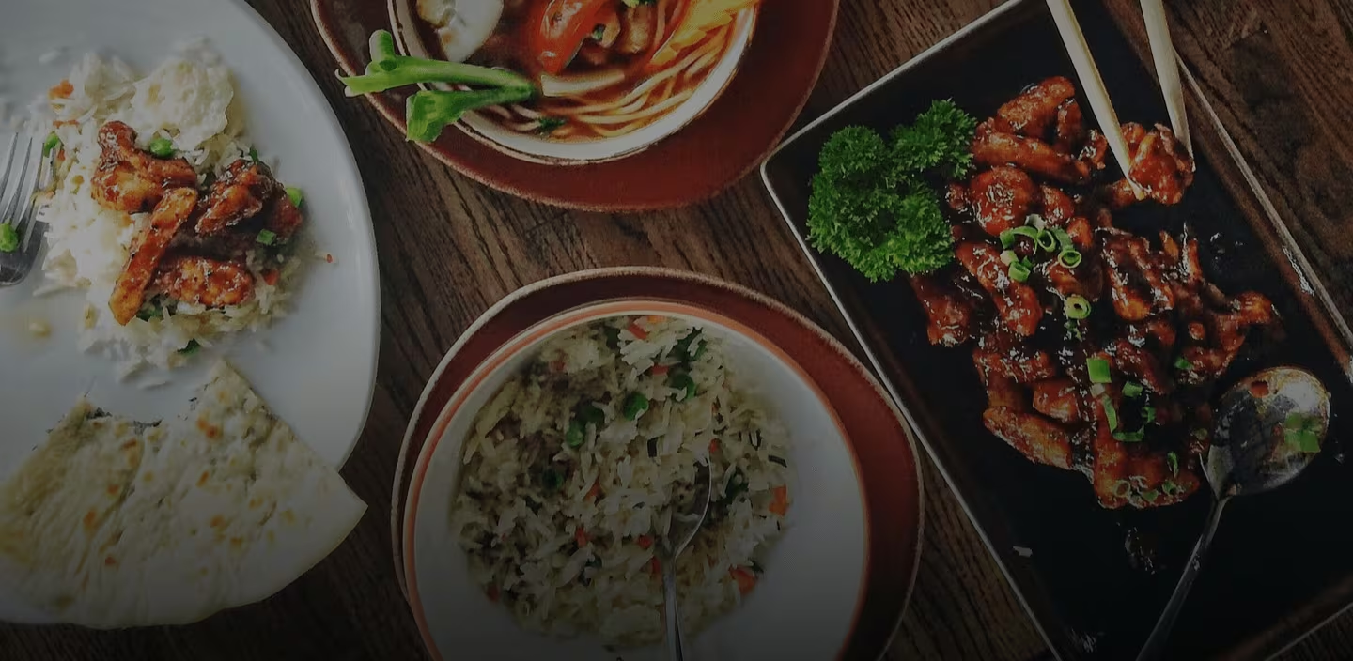
PROJECT BRIEF
Used Excel functions to extract and count data based on specific criteria, and used PivotTables, PivotCharts to summarize the data.
For the SQL Part, the queries have been created according to the given questions.
For better interactive dashboards, used Power BI with help of data modeling, dax formulas and Tableau with help of data blending to combine data and provided valuable insights into restaurant industry trends related to location, opening trends, ratings, and cost range.
The project also explores restaurant growth over time, tracking openings by year, quarter, and month.
Through interactive dashboards, users can filter and compare data dynamically for deeper insights.
This project focuses on analyzing restaurant data from Zomato to uncover key trends and patterns in the food industry.
It showcases the use of Excel, SQL, and BI tools such as Power BI and Tableau for data analysis and visualization.

Slide 4
The dataset consists of restaurant details across multiple countries, including attributes like location, cuisine type, pricing, ratings, and service availability.
It includes key fields such as Restaurant ID, Name, City, Country, Average Rating, Votes, Price Range, Online Delivery Availability, and Table Booking Status.
DATA OVERVIEW
The data allows for comprehensive analysis of restaurant distribution, and customer preferences, such as online delivery adoption, table booking availability, and average restaurant ratings, cost and votes .
A cost segmentation approach categorize restaurants into affordability buckets, providing insights into pricing trends. Additionally time-based data helps track restaurant growth over different periods.

Slide 5
BUSINESS OBJECTIVES [KPIs]
01
02
03
04
05
Leading Country
Restaurant Presence
Table Reservation
Online Delivery
Customer Satisfaction
Identifies the country with the highest number of restaurants.
Total number of restaurants available in the dataset.
Percentage of restaurants offering table reservations.
Percentage of restaurants providing online delivery services.
Average rating given by users across all restaurants.
06
07
08
09
10
User Engagement
Dining Affordability
Top Cities
Pricing Analysis
Restaurant Growth
Average number of votes per restaurant, indicating popularity.
Average cost for two people across all restaurants.
Highlights the cities with the most restaurants.
Categorizes restaurants into affordability segments.
Tracks the number of new restaurants opening over time.
11
12
13
14
15
Top Cuisines
Rating Distribution
Top-Rated Countries
Delivery & Booking Trends
Calendar & Country Table
Identifies the most popular cuisines based on restaurant count.
Shows how restaurants are distributed across different rating levels (1-2, 2-3, 3-4, 4-5)
Highlights countries with the highest average restaurant ratings.
A visual breakdown of restaurants offering Online & Table Booking, highlighting the % split between 'Yes' & 'No' categories.
A structured calendar for time-based trends and a country table for geographic analysis.

Slide 6

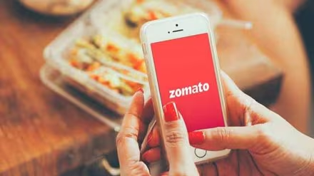
EXPLORATION
Restaurant Presence
Customer Ratings
Growth Over Time
India leads in restaurant count, with New Delhi having the highest concentration.
Majority of restaurants fall within 3.0–4.0 ratings, indicating moderate satisfaction.
In 2018 - 1,102 restaurants opened, a slight rise from 1,086 in 2017.
Pricing Segmentation
Rating Trends Over Country
Customer Preferences
Most restaurants fall into the Mid-Range pricing category based on avg_cost_for_two, indicating balanced affordability.
On average, restaurants in the Philippines have higher ratings compared to other regions.
Average Ratings: 2.89, Average Votes: 156.91,
Average Cost: ₹1,199.2.

Slide 7
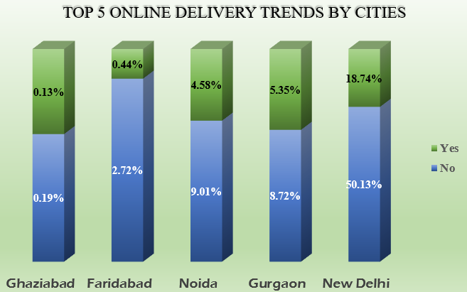
VISUAL OVERVIEW
01
Online Delivery Accessibility in Leading Cities
The data represents the percentage of orders marked as "Yes" (successful deliveries) and "No" (cancellations / failures / table reserved).
✔ New Delhi shows the highest percentage of online orders, with a significant portion marked as delivered.
✔ Gurgaon and Noida also exhibit steady growth in online deliveries, with minimal cancellations.
✔ Ghaziabad and Faridabad have lower online order volumes, indicating potential areas for market expansion.

Slide 8
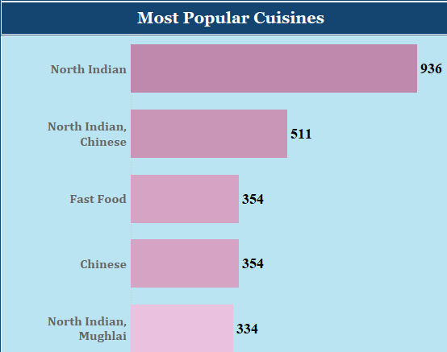
VISUAL OVERVIEW
02
Culinary Trends Across Regions
✔ North Indian cuisine leads the market, followed by Chinese and Fast Food.
✔ Diverse preferences highlight regional variations in dining choices.
✔ Popular cuisines influence restaurant distribution and menu offerings.

Slide 9
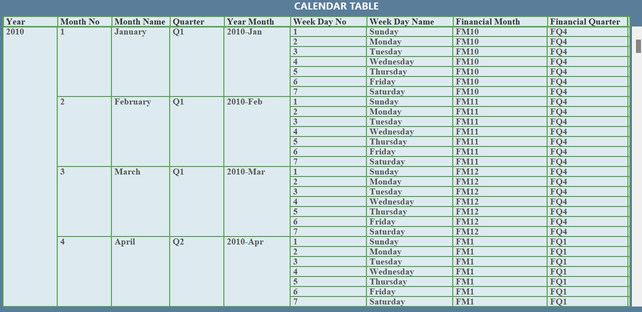
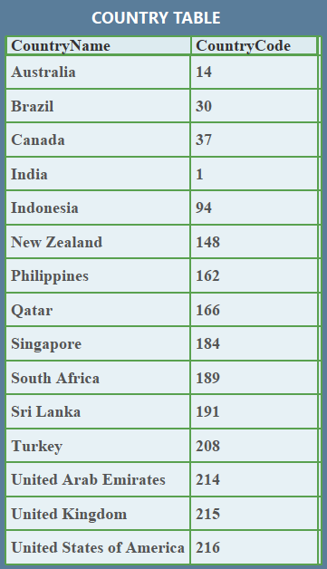

Slide 10
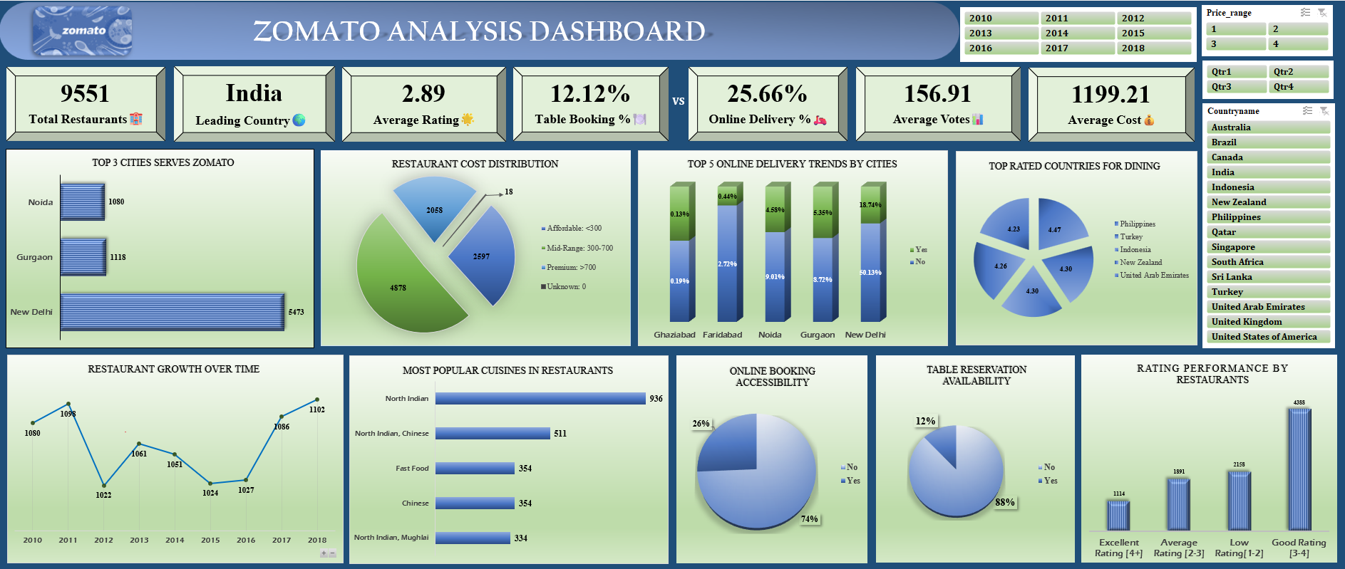

Slide 11
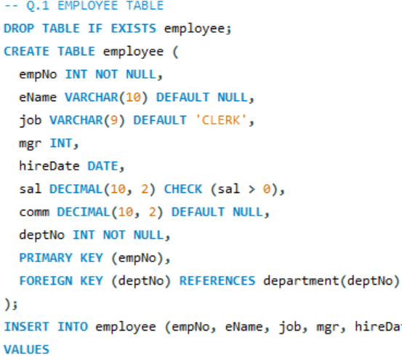
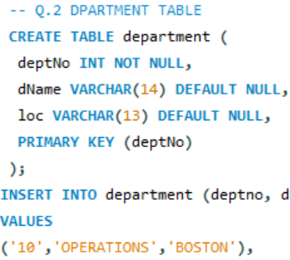
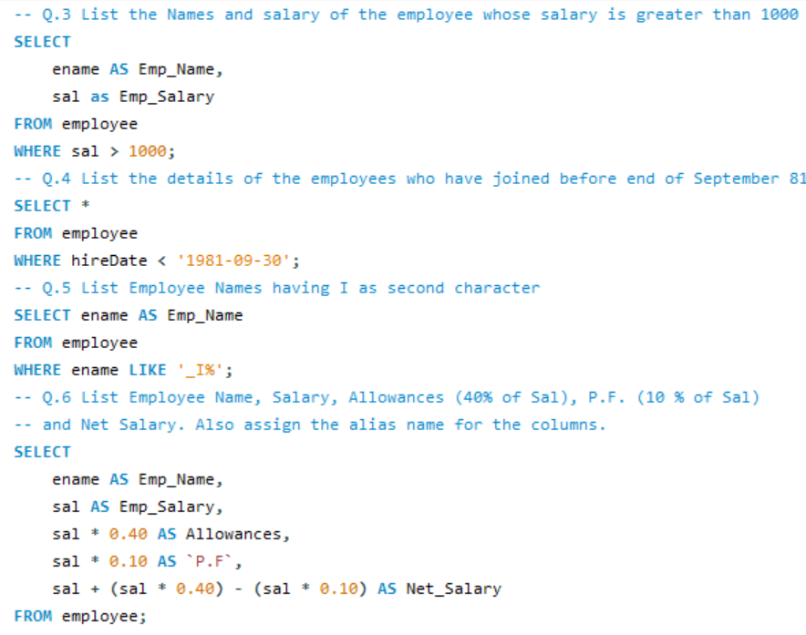
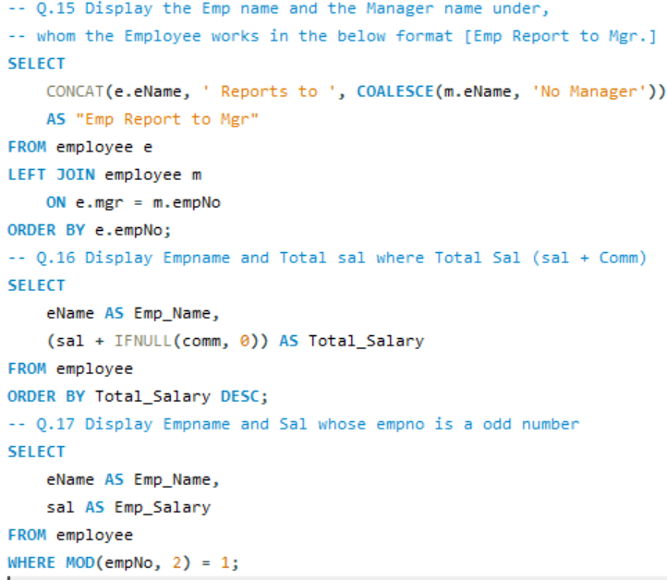
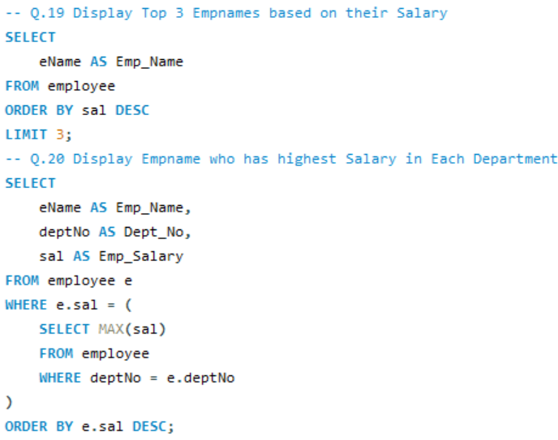

Slide 12
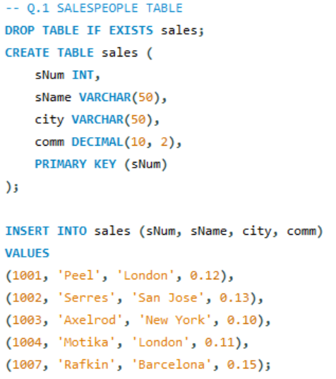
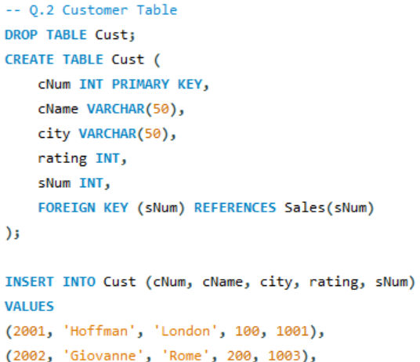
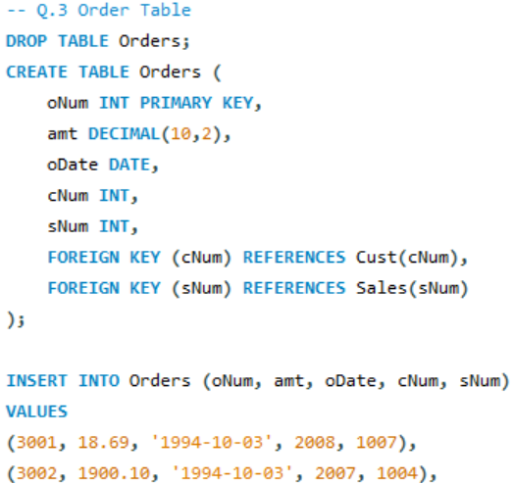
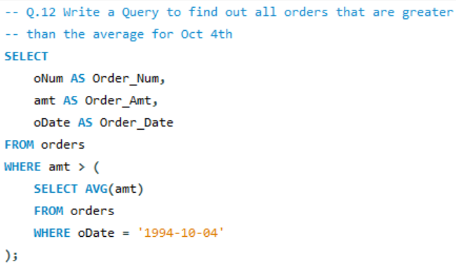
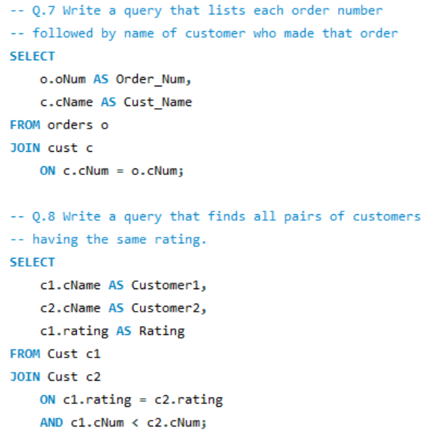
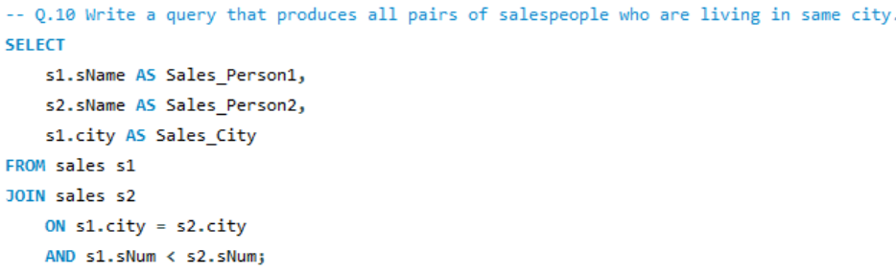
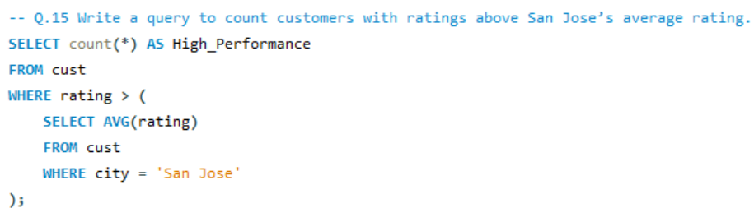

Slide 13
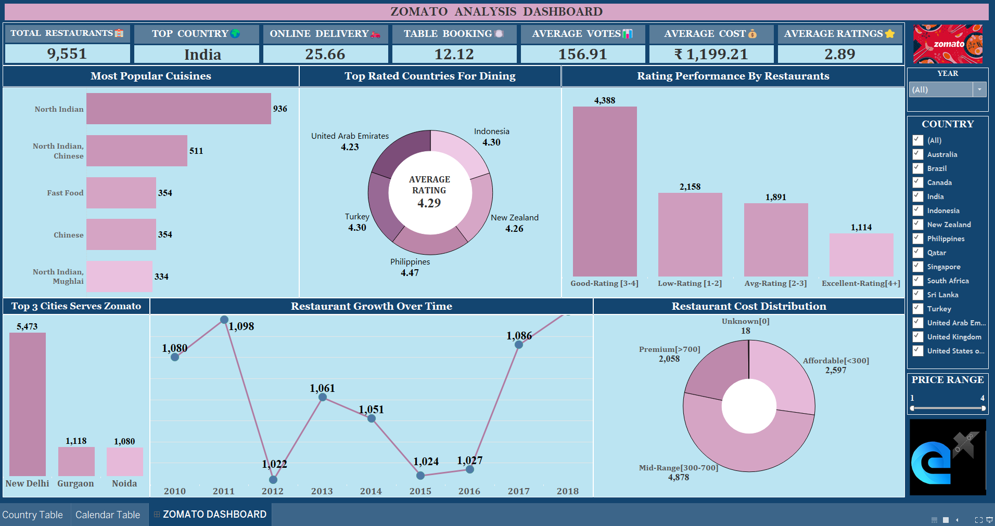

Slide 14
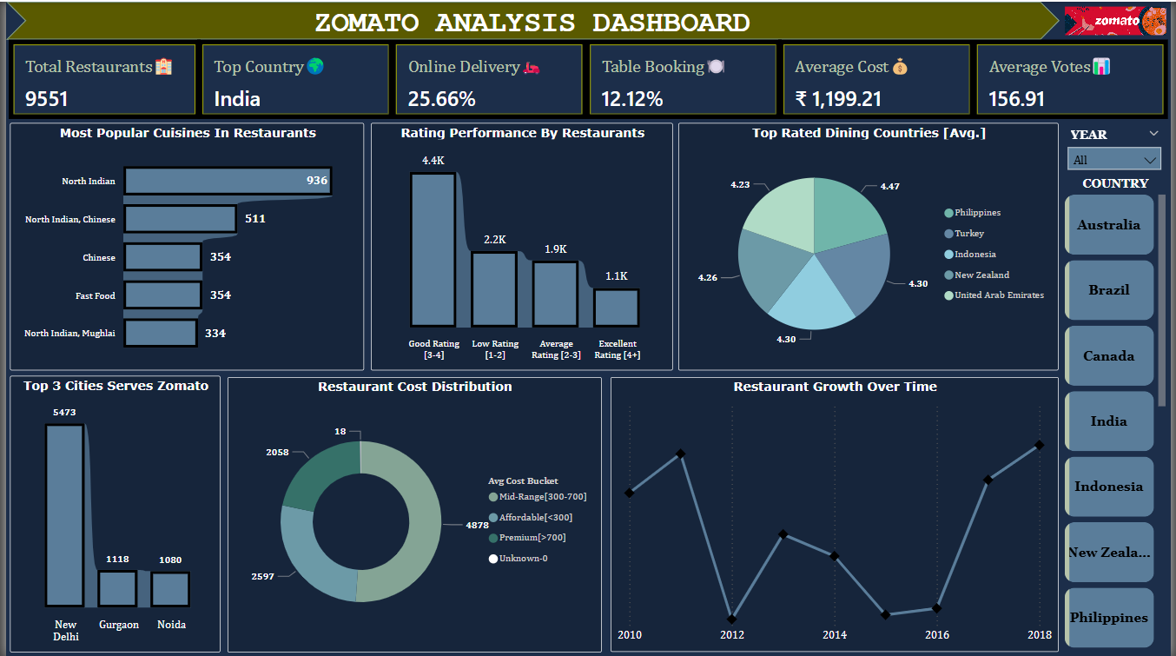

Slide 15
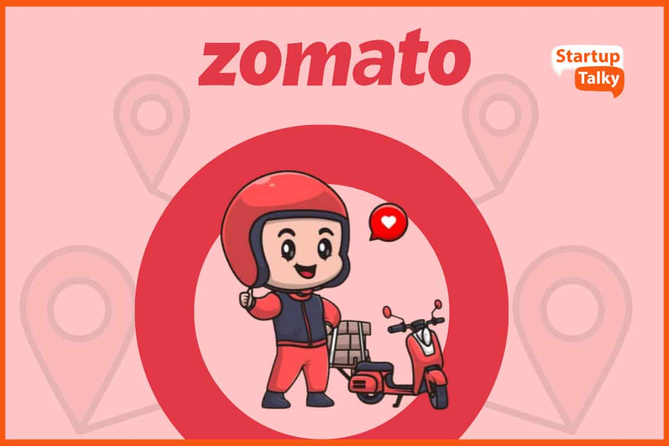
STRATEGIC INSIGHTS
1. AI-Driven Customer Insights
✔ Leverage AI & machine learning to analyze customer preferences.
✔ Use predictive analytics to forecast demand trends.
2. Strategic Location & Market Expansion
✔ Optimize restaurant locations based on foot traffic and demographics.
3. Enhanced Digital Presence & Marketing
✔ Strengthen social media engagement and influencer collaborations.
4. Delivery & Service Optimization
✔ Partner with food delivery platforms to increase market reach.
✔ Implement AI-based route optimization for faster deliveries.
5. Data-Driven Menu & Pricing Strategy
✔ Offer seasonal, region-specific menu items based on demand trends.
✔ Use customer feedback & dynamic pricing to enhance profitability.

Slide 16

KEY TAKEAWAYS
The restaurant industry is evolving, driven by online service adoption, pricing strategies, and regional cuisine preferences. Our Zomato analysis highlights key trends in market growth, customer demand, and service flexibility. Cities with high online delivery adoption reflect shifting consumer behavior, emphasizing the need for a hybrid dine-in and digital model. Success in this space relies on data-driven decisions, innovation, and a customer-centric approach for sustained growth.

